Slide 1
Revise and refresh for MST124:
Welcome to Session 5
Wednesday 22nd September 2021
We’ll start at 7.00pm and aim to finish by 9.00pm
Please check your Audio levels:
Speaker and Microphone setup
This session will cover the topics in
Trigonometry
Please feel free to use the chat box while waiting
Have paper, pen and your calculator to hand.

Slide 2

What we aim to cover tonight
Right angled triangles: sine, cosine and tangent.
Finding unknown lengths.
Finding unknown angles.
Useful trigonometrical ratios and identities.
Sine and Cosine Rules
The area of a triangle.
Angles > 90 degrees.
Graphs of sine, cosine and tangent.
Solving obtuse-angled triangles.
Radians.
Solving simple trigonometrical equations.
See MU123, Unit 12, and MST124, Unit 4.
Notes:
This is a huge amount to cover, and there is no way I can cover everything in detail in an hour and a half. I will have to skate over some stuff, but you will be able to look at the whiteboard at your leisure, if you save it. I will give the instructions for saving it again at the end, and you can also look at the recording of the tutorial.
<number>

Slide 3
What to do
Do the exercises as we go along.
I can’t give you much time to do them, so if necessary do them afterwards.
If you took MU123, go back through Unit 12.
The subject is covered again in Unit 4 of MST124.
If you see a in the top left-hand corner of a frame, this is an issue that students frequently confuse, and lose marks on.
Notes:
Trigonometry is a core topic, that you really need to get on top of. Here are some of the things you can do to make sure that you are okay.
<number>

Slide 4

Measuring the height of a tree
Height
of tree
Notes:
The surveyor wants to find the height of the tree, but he has no way of measuring it directly.
<number>

Slide 5
Measuring the height of a tree
Height
of tree
Horizontal distance from tree
Notes:
He can easily measure his horizontal distance from the tree.
<number>

Slide 6
Measuring the height of a tree
Height of tree
Angle of elevation
Horizontal distance from tree
Notes:
He can also measure the angle of elevation, using a clinometer. With these two bits of information, and some trigonometry, he can work out the height of the tree.
<number>

Slide 7
Measuring the height of a tree
Height of tree
We’ll call it h
metres
Angle of elevation
Let’s say 20˚
Horizontal distance from tree
Let’s say 100 metres
Notes:
He’s has measured his distance from the tree as 100 metres, and the angle of elevation as 20 degrees. The height is unknown, so we give it a letter; h seems the obvious choice.
<number>

Slide 8
Measuring the height of a tree
h
20˚
100 m
Notes:
Let’s strip away the irrelevant information. We’re left with this triangle, but before we can solve the triangle and find h, I need to talk a little bit about basic trigonometry.
<number>

Slide 9
Trigonometry
Basic trigonometry is about the relationships between the lengths of the sides and the angles in right-angled triangles.
Notes:
Let’s have some definitions.
<number>

Slide 10
Terminology
These definitions refer to the angle x in a right-angled triangle.
You should remember that in any triangle, the longest side is opposite the biggest angle, and the shortest side is opposite the smallest angle.
hypotenuse
opposite
x
adjacent
The side opposite the right-angle is called the hypotenuse.
The side opposite the angle x is called the opposite.
The remaining side, the side next to x, is called the adjacent.
Notes:
The hypotenuse must be the longest side, as a right angle must be the biggest angle in any triangle. Remembering this simple rule can save a lot of grief. If the longest side, say, isn’t opposite the largest angle, your solution cannot possibly be correct.
<number>

Slide 11
Similar right-angled triangles
x
x
x
is the same for all three triangles, as are
and
This means that if we know the value of x, we know the value of these ratios – regardless of the size of the triangle. It is this fact that underpins all trigonometry.
Notes:
These three triangles have a right-angle and the same angle, x, so the third angle must also be the same in all three triangles. This means that they are similar. This in turn means that the ratio of any pair of sides is the same in all three triangles. Three of these ratios are the key to trigonometry, and we give them names.
<number>

Slide 12
Terminology
hypotenuse
opposite
x
adjacent
For example, is called the sine of x, which we abbreviate to sin x or sin(x).
(Note that “sin” is pronounced to rhyme with “wine”, not “bin”.)
Notes:
Remind students that the actual lengths of the sides don’t matter. For any angle, x, this ratio is a constant. For instance, if x = 30 degrees, the ratio is ½.
<number>

Slide 13
Terminology
hypotenuse
opposite
x
adjacent
Other ratios are which is the cosine of x, which we write as cos x or cos(x)
and which is the tangent of x, which we write as tan x or tan(x)
Notes:
The values of these ratios for any angle can be looked up on a calculator. There are three more possible ratios, the reciprocals of the ones here, that we call the cosecant, the secant and the cotangent. You will need to read about these. See Section 3 of MST124 (page 74).
<number>

Slide 14
A useful mnemonic
SOHCAHTOA
Remember:
(pronounced “sock-ah-tow-ah”)
If you prefer a more graphic mnemonic, you could try:
Some Old Houses Can Always Hide Their Old Age.
Notes:
Go through the mnemonic step by step. Okay, let’s go back to the tree.
<number>

Slide 15
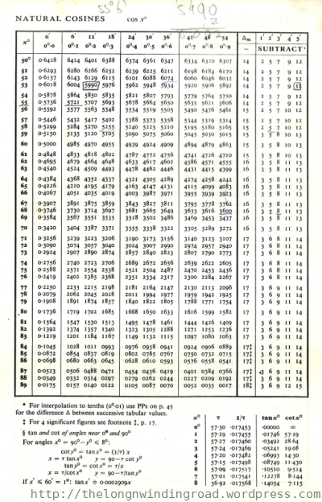

Trigonometric tables
The first table of sines was produced in 499 CE. Once they attained their modern form, they didn’t change a lot until Hewlett Packard produced the first scientific calculator in 1972, thus rendering all such tables redundant.

Slide 16
Measuring the height of a tree
h
20˚
100 m
Notes:
<number>

Slide 17
Measuring the height of a tree
h
20˚
100 m
Notes:
<number>

Slide 18
Measuring the height of a tree
h
20˚
100 m
Notes:
<number>

Slide 19
Measuring the height of a tree
h
20˚
100 m
Remember: always work to full
calculator accuracy, which is 10
significant figures. This is especially important in calculations involving trigonometry, where tiny errors in the input numbers can make a huge difference to the result.
Notes:
<number>

Slide 20
Measuring the height of a tree
h
20˚
100 m
Notes:
And we need to add a conclusion.
<number>

Slide 21
Measuring the height of a tree
h
20˚
100 m
1. Never round until you have
finished the calculation; then
round appropriately for the
conclusion.
2. Always write down the full calculator value as the last line of your working before you round it.
So the height of the tree is 36 metres, to the nearest metre.
Notes:
Sir George Everest measured the height of the tallest mountain in this world using this technique.
<number>

Slide 22
Finding angles
23 cm
13 cm
x
What is the value of x?
Notes:
<number>

Slide 23
Finding angles
23 cm
13 cm
x
We want the inverse of sin, just as
subtraction is the inverse of addition,
or square root is the inverse of square.
Finding the inverse is the operation that gets you back to where you started.
Notes:
We want x, not sin x, so the operation is the inverse of sine, which cancels out the sine. We need to do this to both sides, and it looks like this:
<number>

Slide 24
Finding angles
23 cm
13 cm
x
Sin⁻¹ is the generally
accepted notation but
it can also be written
as arcsin or asin, and
you may find any of
these symbols on your
calculator.
Sin⁻¹ and sin cancel
each other out, not
because sin⁻¹ is the
reciprocal of sin –
it isn’t – but because
it is the inverse.
Notes:
We need to do the same thing to both sides. Sin and arcsin cancel out, which is why we did it, leaving the equation as we see it.
<number>

Slide 25
Finding angles
23 cm
13 cm
x
Never convert a number to a
decimal in the middle of a
calculation; always work with
the most accurate figure
possible. Modern calculators
can do the calculation in this
form.
Notes:
<number>

Slide 26
Finding angles
23 cm
13 cm
x
Notes:
<number>

Slide 27

sin⁻¹(x) and (sinx)⁻¹
Do not confuse these two operations:
Notes:
Note the difference between the reciprocal and the inverse. The -1 in sin^-1 has nothing to do with powers.
<number>

Slide 28
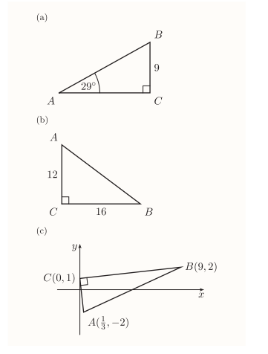
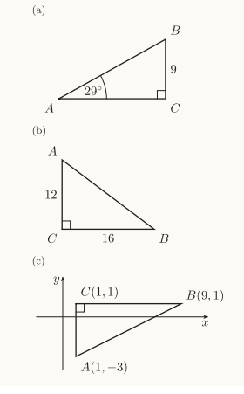
Finding lengths & angles
Find all the unknown lengths and angles.
These questions, like all those I have asked in this tutorial, are taken from the MST124, Unit 4 Exercise Book, which is available on the MST124 website.
Notes:
<number>

Slide 29
Finding lengths & angles
Notes:
<number>

Slide 30
Two useful triangles
30,60,90 and 45,45,90.
2
√2
1
1
√3
1
It is well worth remembering these triangles
and their values. They occur a lot.
Notes:
<number>

Slide 31
Relationship between sine and cosine
y
hypotenuse
opposite
x
adjacent
Notes:
Look at the angle y. The sine of x is the cosine of y, and vice versa, but y is 90 – x, so we have the identities: sin(x) = cos(90 – x) and cos(x) = sin(90 – x).
<number>

Slide 32
Relationship between sine, cosine and tan.
Notes:
We have a simple relationship between sine, cosine and tangent.
<number>

Slide 33
Relationship between sin and cos
This is a very important identity, so I’ll repeat it
sin²x + cos²x = 1
Note that, unlike sin⁻¹x, sin²x is the same as (sin x)², and
by convention we always write sin²x. This is an unfortunate
confusion of notation when you are first learning, but you
will soon become used to it.
Notes:
Using Pythagoras’ Theorem.
<number>

Slide 34
Extending basic trigonometry
We need to be able to:
Solve any type of triangle, not just right-angled ones.
Work with angles of more than 90 degrees.
Notes:
<number>

Slide 35
Sine Rule
In any triangle
B
c
a
By convention, if we label the sides of a triangle a, b and c, and the angles A, B and C, then a is the side opposite angle A, b is the side opposite angle B, and so on.
The statements of the Sine and Cosine Rules assume that this
convention is being used.
A
b
C
Notes:
<number>

Slide 36
Sine Rule
In any triangle
80˚
10
35˚
x
Notes:
A over sin A just means, “a side and the angle opposite it”. Your triangle may be labelled differently, so be careful.
<number>

Slide 37
Sine Rule
In any triangle
80˚
10
35˚
x
Notes:
A over sin A just means, “a side and the angle opposite it”. Your triangle may be labelled differently, so be careful.
<number>

Slide 38
Sine Rule
In any triangle
80˚
10
35˚
x
Notes:
A over sin A just means, “a side and the angle opposite it”. Your triangle may be labelled differently, so be careful.
<number>

Slide 39
Sine Rule
In any triangle
80˚
10
35˚
x
There is no need to convert
sin 80° and sin 35° to decimals.
Just enter the whole expression
into your calculator as it stands.
It’s quicker, it’s more accurate, and it reduces the chances of making an error.
Notes:
A over sin A just means, “a side and the angle opposite it”. Your triangle may be labelled differently, so be careful.
<number>

Slide 40
Sine Rule
In any triangle
80˚
10
35˚
x
Hence x = 17.2 (to 3 sf)
Notes:
A over sin A just means, “a side and the angle opposite it”. Your triangle may be labelled differently, so be careful.
<number>

Slide 41
Cosine Rule
In any triangle
B
c
a
A
b
C
Notes:
Again, a is any angle in the triangle, A is the angle opposite it, and b and c are the other two angles. Don’t get hooked on the letters. We could write the formula as b^2 = a^2 + c^2 – 2 a c cos(b), or we could use p, q and r.
<number>

Slide 42
Cosine Rule
In any triangle
For example, if you are interested in the angle at B, the formula becomes
Notes:
Again, a is any angle in the triangle, A is the angle opposite it, and b and c are the other two angles. Don’t get hooked on the letters. We could write the formula as b^2 = a^2 + c^2 – 2 a c cos(b), or we could use p, q and r.
<number>

Slide 43
Cosine Rule to find side length
B
78˚
5.6m
We are looking for the side opposite angle B, so we use the formula in the form
7.7m
C
A
The side on the left-hand side of the equation must be the side opposite the angle on the right-hand side. Getting this wrong is a very common mistake.
Notes:
Here, the triangle is labelled differently from the formula, so we need to alter the formula to conform to the triangle. Explain this carefully.
<number>

Slide 44
Cosine Rule to find side length
B
78˚
5.6m
We are looking for side B, so we use the
formula in the form
7.7m
C
A
Notes:
Here, the triangle is labelled differently from the formula, so we need to alter the formula to conform to the triangle. Explain this carefully.
<number>

Slide 45
Cosine Rule to find side length
B
78˚
5.6m
We are looking for side B, so we use the
formula in the form
7.7m
C
A
Notes:
Here, the triangle is labelled differently from the formula, so we need to alter the formula to conform to the triangle. Explain this carefully.
<number>

Slide 46
Cosine Rule to find side length
B
78˚
5.6m
We are looking for side B, so we use the
formula in the form
7.7m
C
A
Notes:
Here, the triangle is labelled differently from the formula, so we need to alter the formula to conform to the triangle. Explain this carefully.
<number>

Slide 47
Cosine Rule to find side length
B
78˚
5.6m
We are looking for side B, so we use the
formula in the form
7.7m
C
A
Hence the length of AC is 8.5 m (to 2 sf)
Notes:
Here, the triangle is labelled differently from the formula, so we need to alter the formula to conform to the triangle. Explain this carefully.
<number>

Slide 48
Cosine Rule to find angle
4
7
x
10
Notes:
<number>

Slide 49
Cosine Rule to find angle
4
7
x
By the Cosine Rule
10
Notes:
<number>

Slide 50
Cosine Rule to find angle
4
7
x
By the Cosine Rule
10
Notes:
<number>

Slide 51
Cosine Rule to find angle
4
7
x
By the Cosine Rule
10
Notes:
<number>

Slide 52
Cosine Rule to find angle
4
7
x
By the Cosine Rule
10
Notes:
<number>

Slide 53
Cosine Rule to find angle
4
7
x
By the Cosine Rule
10
Notes:
<number>

Slide 54
Cosine Rule
In any triangle
B
What happens if angle A is equal to 90 degrees. What do you get?
c
a
A
b
C
Notes:
If angle A is equal to 90 degrees, cos(a) = 0, and you have a statement of Pythagoras’ Theorem. In other words, Pythagoras’ Theorem can be considered as a special case of the Cosine Rule. S
<number>

Slide 55
Sine and Cosine Rules
Don’t confuse the sine and cosine ratios with the Sine and Cosine Rules.
The sine, cosine and tangent ratios only hold for right-angled triangles
The Sine and Cosine Rules work in non-right-angled triangles. They could be used in right-angled triangles, but they are the not the simplest tool for the job. It’s a bit like using a calculator to add 4 and 5.
Notes:
<number>

Slide 56
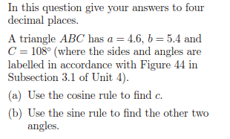
One to try ...
Notes:
<number>

Slide 57


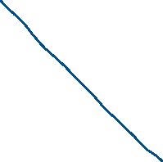





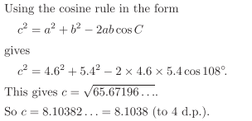

Slide 58




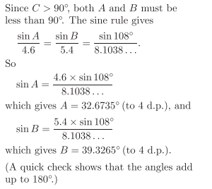

Slide 59
One to try ...
Notes:
<number>

Slide 60

The area of a triangle
If angle C is 90 degrees, this formula reduces to the familiar
A = ½ base x height
since sin(90) is equal to 1.
Notes:
<number>

Slide 61
Other angles
What is the meaning of
sin(150˚)
cos(1000˚)
tan(-45˚)
Notes:
They aren’t covered by our definition of sin, cos and tan, which only applies to right-angled triangles, but your calculator will give you values for them, so ...
<number>

Slide 62
Other angles
Also, we want the Sine and Cosine Rules to work in obtuse-angled triangles.
We need to change the definition of sine, cosine and tangent.
Notes:
This happens often in maths, for example in extending numbers to fractions and negatives, and powers to fractions and negatives. We have to make sure that the new definitions are compatible with the old ones.
<number>

Slide 63

Terminology
A general angle is a measure of rotation round a point, measured in degrees. Positive angles give anticlockwise rotations, and negative angles give clockwise rotations.
If we are going to change the definition of sine, cosine and tangent, we must make sure that the new definition gives the same results as the old one for right-angled triangles.
Notes:
<number>

Slide 64
The ASTC diagram
Right round the circle would be 360˚, and since we can go round the circle as many times as we like, an angle of 1000˚ does make sense, as does an angle of -45˚.
Notes:
Explain the four quadrants.
<number>

Slide 65
Points on the unit circle: 1st quadrant
By our original definition,
sin(θ₁) = y₁/r = y₁, since
r = 1, so sin(θ₁) is the y-
coordinate of the point P₁,
and this is our new
definition of sin(θ₁).
Notes:
Explain the four quadrants.
<number>

Slide 66
Points on the unit circle: 1st quadrant
Similarly, cos(θ₁) is
defined as the x-coordinate
of P₁.
These definitions are identical
to the original ones in the
first quadrant, but they allow
us to define sin, cos and tan
for angles greater than 90˚.
And tan(θ₁) is defined as
the y-coordinate of P₁
divided by the x-coordinate.
Notes:
<number>

Slide 67
Points on the unit circle: 2nd quadrant
Note that in the second quadrant,
x is negative; whereas y is positive,
so in this quadrant, sine is positive,
but cosine and tangent are negative.
Notes:
Point out that the y-coordinate for 30 degrees and 150 degrees is the same, so the sine is the same.
<number>

Slide 68
Implications for the Sine Rule
sin(x) = sin(180 – x)
so, for example
sin(140) = sin(40)
With the Sine Rule, there are two possible answers for angles,
and you need to make sure you have the right angle.
Notes:
You can easily check this with your calculator. Explain that there are no such problems with the cosine rule: angles between 90 degrees and 180 degrees have negative cosines.
<number>

Slide 69
Sine Rule: getting the right angle
Make sure you know whether the triangle has two acute angles and an obtuse angle, or three acute angles. If necessary, draw a rough sketch of the triangle.
Remember the rule that the biggest angle is opposite the longest side, and the smallest angle is opposite the shortest side.
This problem doesn’t arise with the Cosine Rule, because cosines are negative in the second quadrant.
Notes:
<number>

Slide 70
Points on the unit circle: 3rd quadrant
Tangent is positive.
Notes:
<number>

Slide 71
Points on the unit circle: 4th quadrant
Cosine is positive.
Notes:
<number>

Slide 72
The ASTC diagram
First quadrant: All positive
Second quadrant: Sine positive
Third quadrant: Tangent positive
Fourth quadrant: Cosine positive
Note that, for example -45° and 315° are both in the fourth quadrant. They have the same sine, cosine and tangent.
Notes:
<number>

Slide 73
Degrees and radians
Radians are units for measuring angles, which can be used as an alternative to degrees.
We have
or
1 radian = 57.296 degrees (to 5 sf)
Never use the decimal equivalent in calculations.
You will find conversions for principle angles on page 6 of MST124, Unit 4.
Never use the decimal equivalent in calculations. Always use 180/π; it’s more accurate. You will find conversions for principal angles on page 6 of MST124, Unit 4.
Notes:
You might ask, why introduce a new measure? We’ve been using degrees for thousands of years, and they are very convenient. Unfortunately, many mathematical formulae are much simpler if angles are measured in radians, so much so that degrees are almost never used in some branches of higher mathematics. You will meet some of these formulae during the course of MST124.
<number>

Slide 74

Degrees and radians
Calculator Health Warning!
If you work in both degrees and
radians, always check your
calculator setting every time
you start work.
Notes:
You would be amazed how many answers I mark that are wrong simply because the student has forgotten to reset their calculator from degrees to radians, or vice versa.
<number>

Slide 75
Round and round the circle (degrees)
Things to note:
We can have angles of any size. Twice round the circle is 720°.
Sin lies between -1 and 1.
Sin 90° = sin 450° = sin (-270°) and so on.
The graph is symmetrical over a given range so, for example, sin(30°) is equal to sin(150°) (which is 180 – 30)
Notes:
This is the graph of y = sin(x). Explain the various features.
<number>

Slide 76
Round and round the circle (radians)
Sin(π/2) = sin(5π/2) = sin(-3π/2) and so on.
Notes:
<number>

Slide 77
Round and round the circle (degrees)
Things to note:
The cosine graph is the sine graph translated to the left by 90° or π/2 radians.
The symmetries are different, so whereas sin(x°) = sin(180° – x°), we have cos(x°) = cos(360° – x°).
Notes:
This is the graph of y = cos(x). Explain the various features.
<number>

Slide 78
Round and round the circle (degrees)
There is no value for tan(90°), tan(270°) and so on. For these values, cos(x) is zero, and we cannot divide by zero.
Notes:
This is the graph of y = cos(x). Explain the various features.
<number>

Slide 79
Trigonometrical equations
Solve the equation sin(x)=0.5
If we put into a calculator, we get
the answer
But this isn’t the whole story
Notes:
<number>

Slide 80
Trigonometrical equations
Solve the equation sin(x)=0.5
Solutions
Notes:
<number>

Slide 81
Trigonometrical equations
An equation like sin(x) = 0.5 has infinitely many solutions.
The principal solution is x = 30°, or π/6 radians.
We restrict the number of solutions by giving a range, ie –π < x < π, or
Notes:
Go back to the graph to show the four solutions.
<number>

Slide 82
Trigonometrical equations
From the graph, and using its symmetry, if sin(x) = 0.5, we have
We can also use the identity
Notes:
<number>

Slide 83
Important identities for solving equations
Two values of sin, cos, tan between 0 and 2π.
If you want values outside the range 0 to 2π radians (or 0° to 360°), you can also use these identities:
All these last three identities are saying is that if you add or subtract any multiple
Of 2π radians or 360° to an angle, the sine, cosine and tangent will be the same.
I strongly recommend using both methods: the graph and the identities, and
checking between them, until you are completely comfortable with the process. This will help you to understand what is going on, and improve your grasp of the techniques. Using the graph will help you to make sure that you don’t miss any solutions.
Notes:
<number>

Slide 84
Trigonometrical equations
Solve
Notes:
<number>

Slide 85
Trigonometrical equations
Solve
The principal value is
Notes:
<number>

Slide 86
Trigonometrical equations
Notes:
Point out the two solutions
<number>

Slide 87
Trigonometrical equations
We can see that there are two solutions between –π and π.
Cos(2π – x) gives 7π/4, which is outside the range, but you can always add or subtract 2π radians (or 360°), which is once round the circle, so we subtract 2π
From this, we get –π/4, which is in the range.
So the solution is x = –π/4 or π/4, which you can check with your calculator.
Notes:
<number>

Slide 88

One to solve ...
Notes:
<number>

Slide 89
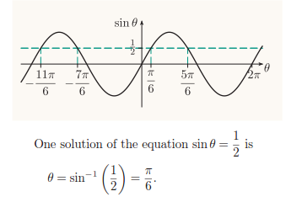
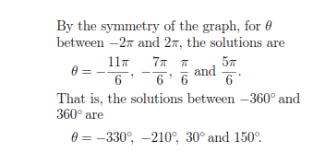
One to solve ...
(a)
Notes:
<number>

Slide 90
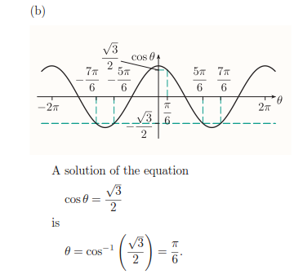
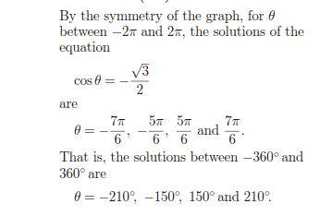
One to solve ...
Notes:
<number>

Slide 91
Preparing for MST124: Session 6
is on Friday 24th September
We’ll start at 7.00pm and aim to finish at 9.00pm
This session will cover the topics in
Exponentials and Logarithms
that you will need to know
Have paper, pen and your calculator to hand.
Notes:
<number>

